Slide 1




ANANTHA LAKSHMI
INSTITUTE OF TECHNOLOGY AND SCIENCE
Approved by AICTE, New Delhi & Affiliated to J.N.T.U. Anantapur, Accredited by NAAC
Near S.K. University, Itikalapalli(V), Anantapur (Dist) Pin: 515721 A.P.
(2021-2025)
Flight Delay Forecasting using Machine Learning Approaches
BACHELOR OF TECHNOLOGY
in
DEPARTMENT OF COMPUTER SCIENCE AND ENGINEERING
Devangam Harathi 212G1A0571
Shaik Sohail 222G5A0514
Madiga Shireesha 212G1A0594
K. Kiran Kumar 212G1A0591
V. Adi Keshava Reddy 212G1A05C1
V. Pradeep Kumar Naik 212G1A05B9
Under Supervision of
Dr. K. Bhargavi M. Tech, Ph.D.,
Associate Professor & HOD,

Slide 2
CONTENTS:
ABSTRACT
INTRODUCTION
EXISTING SYSTEM
PROPOSED SYSTEM
SYSTEM DESIGN
TEST CASES
RESULTS
CONCLUSION

Slide 3
ABSTRACT:
Flight delays pose a significant challenge in the aviation sector. Over the past two decades, the rapid growth fair travel has led to increased air traffic congestion, resulting in frequent delays. These delays not only lead to substantial financial losses but also have negative environmental consequences. Airlines incur significant economic setbacks due to disruptions in flight schedules and actively implement measures to minimize delays and cancellations. This study employs machine learning models, including Logistic Regression, Decision Tree Regression, Random Forest Regression, and Gradient Boosting Regression, to predict whether a specific flight will experience a delay upon arrival.
Keywords:
Flight Delay Prediction, Machine Learning, Logistic Regression, Decision Tree, Bayesian Ridge, Random Forest, Gradient Boosting, U.S. Flight Data, Error Calculation Hyperparameter tuning and cross-validation techniques are applied to optimize performance and mitigate overfitting. This data-driven methodology enhances forecasting capabilities, minimizing travel disruptions and improving efficiency.

Slide 4
1.1 Project Related work:
Flight delay prediction has been extensively studied using statistical methods, machine learning models, and deep learning techniques. Early approaches relied on regression analysis and time series modeling to identify key factors influencing delays, such as weather conditions and air traffic congestion. With the advancement of machine learning, models like Decision Trees, Random Forest, and XG Boost have significantly improved predictive accuracy by incorporating diverse flight and airport-related features. Recent developments in deep learning, including LSTMs and Graph Neural Networks (GNNs), have further enhanced delay predictions by capturing spatio-temporal dependencies in air traffic.
1.2 Existing System:
Supervised automatic learning algorithms Support Vector Machine and the k-nearest neighbor to predict delays in the arrival of operated flights including the five busiest US airports. The precision achieved was very low with gradient booster as a classifier with a limited data set. Applied machine learning algorithms k-Nearest Neighbors to predict delays on individual flight. Flight schedule data and weather forecasts have been incorporated into the model. Sampling techniques were used to balance the data and it was observed that the accuracy of the classifier trained without sampling was more that of the trained classifier with sampling techniques.

Slide 5
1.3 Existing System Problems:
The existing system’s non-parametric nature leads to inconsistencies in predictions as it does not assume a specific functional relationship between variables. Predictability varies due to factors like origin-destination pairs and forecast horizon, making delay predictions unreliable. Additionally, forecasts rely on a limited set of attributes, often missing key influences like weather and seasonal variations. Traditional algorithms like Multiple Linear Regression, SVM, and KNN struggle with large datasets and non-linear relationships, reducing accuracy. To address these limitations, an advanced system integrating real-time data and sophisticated machine learning techniques is needed for more precise flight delay predictions.
1.4 Proposed Systems:
The proposed system aims to develop a robust flight delay prediction model using machine learning techniques. The system leverages historical flight data, analyzing key variables such as flight schedules, airline operations, weather conditions, and seasonal trends to forecast delays accurately. The model will assist airlines and airport management in minimizing disruptions and optimizing flight schedules.

Slide 6
2. INTRODUCTION:
Flight delays have become a persistent challenge in the aviation industry, impacting passengers, airlines, and airport operations worldwide. The rapid expansion of air traffic over the 1717 past two decades has led to increased congestion, resulting in frequent delays and financial losses for airlines. Delays not only cause inconvenience to passengers but also have environmental and economic implications, such as increased fuel consumption and higher operational costs. To mitigate these challenges, predictive modeling using statistical and machine learning techniques has emerged as a valuable approach in forecasting flight delays and improving airline efficiency.
This study explores the effectiveness of various predictive models, including regression models, econometric models, random forests, and support vector machines (SVM), in analyzing and predicting flight delays. By leveraging historical flight data from Jomo Kenyatta International Airport, this research aims to identify the most accurate model for predicting delays, considering key variables such as flight schedules, airline operations, and seasonal factors. The study employs machine learning techniques to develop robust predictive models that can assist airlines in minimizing disruptions and enhancing operational planning.

Slide 7
3. EXISTING SYSTEM:
Supervised automatic learning algorithms Support Vector Machine and the k-nearest neighbor to predict delays in the arrival of operated flights including the five busiest US airports. The precision achieved was very low with gradient booster as a classifier with a limited data set. Applied machine learning algorithms k-Nearest Neighbors to predict delays on individual flight. Flight schedule data and weather forecasts have been incorporated into the model. Sampling techniques were used to balance the data and it was observed that the accuracy of the classifier trained without sampling was more that of the trained classifier with sampling techniques.
Disadvantages of Existing Systems:
Non-parametric nature don’t assume a particular functional form of the response under investigation data.
The predictability may additionally range because of factors such as the number of origin destination pairs and the forecast horizon.
The forecasts were based on some key attributes.
Algorithm: SVM, Logistic Regression, Random Forest.

Slide 8
4. PROPOSED SYSTEM
4.1 INTRODUCTION:
The proposed system aims to predict flight delays using machine learning models trained on historical flight data. The dataset used for training is obtained from the Bureau of Transportation, U.S. Statistics, which includes records of all domestic flights from the year 2015. This dataset provides comprehensive information such as scheduled and actual departure times, scheduled and actual arrival times, elapsed time, taxi-out time, cancellation, rerouting, and airborne time.
The dataset consists of 31 attributes with 20,277 records, and it is designed to be scalable for further data inclusion. The missing values in the dataset are handled efficiently using the Pandas library, ensuring the data is well-prepared for machine learning model training. The system leverages supervised learning techniques to analyze flight schedules and real-time arrival data to enhance the accuracy of delay predictions.
Algorithms: Logistic Regression with SVM,graientBoosting

Slide 9
4.2 OBJECTIVES:
The primary goal of this model is to minimize flight delays and cancellations by examining key flight attributes such as arrival performance, flight history, and departure locations. This enables airlines and passengers to make well-informed travel decisions, enhancing overall air travel efficiency.
4.2.3 ADVANTAGES OF THE PROPOSED SYSTEM
Higher Accuracy: Machine learning and deep learning models will lead to more accurate delay predictions compared to traditional statistical methods.
Real-Time Analysis: The system can predict delays in real-time, allowing airlines to take preventive actions and improve operational efficiency.
Scalability: The system can handle large datasets and complex features, making it more scalable for use across different airlines and airports

Slide 10
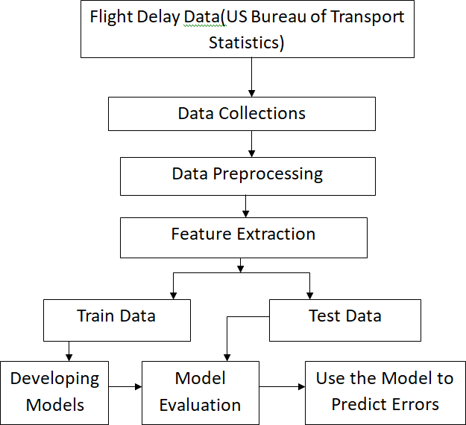
4.3 Flight delay prediction model:
Fig. Project Architecture

Slide 11
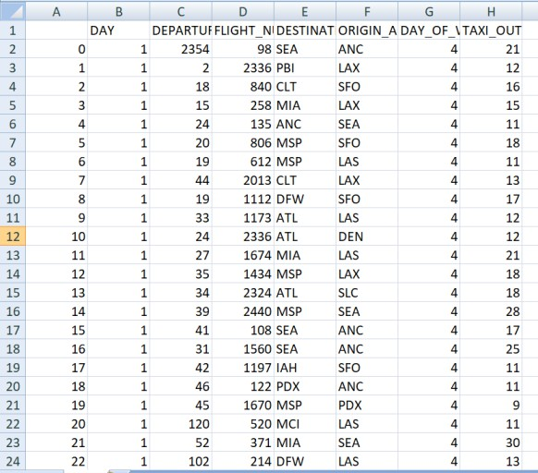
4.3.1 Flight Delay Data:
The dataset used for delay prediction consists of essential flight details, including departure times, airport locations, and operational conditions affecting schedules. Critical parameters include flight number, departure time, departure and arrival airports, day of the week, and taxi-out duration.
By analyzing these factors, machine learning models can identify patterns linked to delays caused by congestion, weather conditions, and airport constraints.
4.3.2 Data Collection:
The dataset is compiled from the U.S. Bureau of Transportation Statistics and airline databases.
It includes flight schedules, departure and arrival details, airport-specific information, weather conditions, taxi-out durations, and historical delay records. This extensive dataset enhances delay pattern analysis and improves forecasting accuracy, supporting airlines and passengers in travel planning.

Slide 12
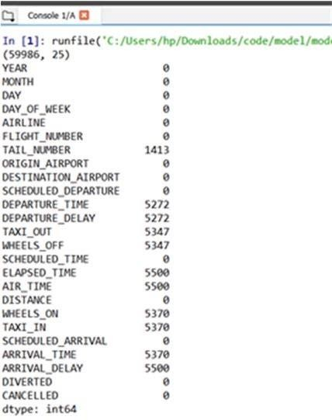
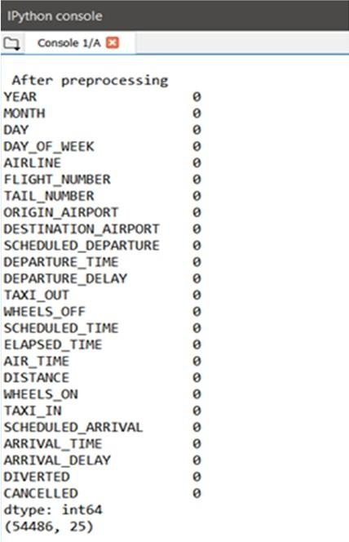
4.3.3 Data Preprocessing:
Prior to applying machine learning algorithms, preprocessing is performed to ensure data reliability. The dataset, sourced from transportation records, consists of 25 attributes and nearly 60,000 records. Missing values are addressed using Pandas' dropna() function to eliminate inconsistencies while preserving valuable information for model training.
Fig: 3.1.4.1: Before Data Preprocessing Fig: 3.1.4 .2: After Preprocessing

Slide 13
4.3.4 Train and Test Data Splitting:
To ensure effective model performance, the dataset is divided into an 80% training set and a 20% testing set using Scikit-learn’s train_test_split() function.

Slide 14
4.4 System Requirements:
1. Hardware Requirements:
System : Intel Core i7.
Hard Disk : 1TB.
Monitor : 15’’ LED
Input Devices : Keyboard, Mouse
Ram : 16GB.
2. Software Requirements:
Operating system : Windows 10.
Coding Language : Python
Tool : PyCharm, Visual Studio Code
Database : SQLite3

Slide 15
4.5 Advantages of Proposed System:
Utilizes supervised learning with scheduled and actual flight times.
Implements computationally efficient algorithms.
Predicts delays based on multiple influencing factors.
Employs models like Logistic Regression, Decision Tree Regressor, Bayesian Ridge, Random Forest Regressor, and Gradient Boosting Regressor for accuracy.
4.6 ALGORITHMS:
Logistic Regression:
Predicts delay time based on factors like weather, departure time, and congestion.
Example: Estimating delay in minutes using wind speed and humidity.
SVM - SVR (Support Vector Regression):
Handles non-linear flight delay patterns.
Uses kernel functions (RBF, polynomial) for better accuracy.
GridBoosting:
Optimizes SVM hyperparameters (C, epsilon, kernel).
Uses cross-validation to prevent overfitting.

Slide 16
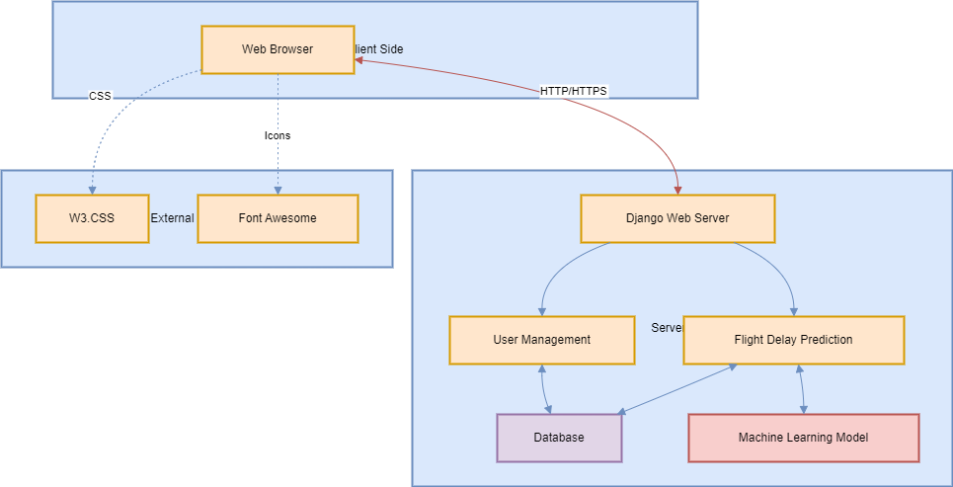
5. SYSTEM DESIGN:
5.1 SYSTEM ARCHITECTURE:

Slide 17
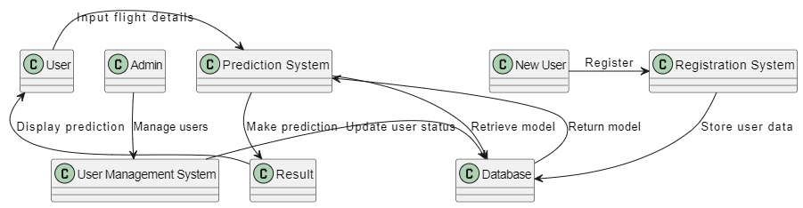
5.2 DATA FLOW DIAGRAM:
The DFD is also called as bubble chart. It is a simple graphical formalism that can be used to represent a system in terms of input data to the system, various processing carried out on this data, and the output data is generated by this system.
The data flow diagram (DFD) is one of the most important modeling tools. It is used to model the system components. These components are the system process, the data used by the process, an external entity that interacts with the system and the information flows in the system.
DFD shows how the information moves through the system and how it is modified by a series of transformations. It is a graphical technique that depicts information flow and the transformations that are applied as data moves from input to output.

Slide 18
5.3 UML DIAGRAMS:
UML stands for Unified Modeling Language. UML is a standardized general-purpose modeling language in the field of object-oriented software engineering. The standard is managed, and was created by, the Object Management Group.
The goal is for UML to become a common language for creating models of object oriented computer software. In its current form UML is comprised of two major components: a Meta-model and a notation. In the future, some form of method or process may also be added to; or associated with, UML.
The Unified Modeling Language is a standard language for specifying, Visualization, Constructing and documenting the artifacts of software system, as well as for business modeling and other non-software systems.
The UML represents a collection of best engineering practices that have proven successful in the modeling of large and complex systems.
The UML is a very important part of developing objects oriented software and the software development process. The UML uses mostly graphical notations to express the design of software projects.

Slide 19
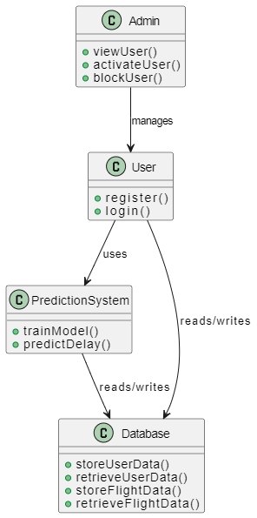
GOALS: The Primary goals in the design of the UML are as follows:
Provide users a ready-to-use, expressive visual modeling Language so that they can develop and exchange meaningful models.
Provide extendibility and specialization mechanisms to extend the core concepts.
Be independent of particular programming languages and development process.

Slide 20
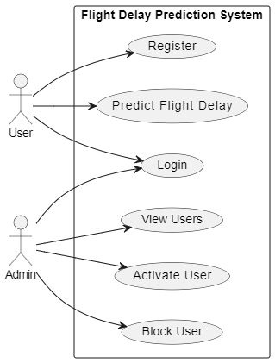
5.4 USE CASE DIAGRAM:
A use case diagram in the Unified Modeling Language (UML) is a type of behavioral diagram defined by and created from a Use-case analysis. Its purpose is to present a graphical overview of the functionality provided by a system in terms of actors, their goals (represented as use cases), and any dependencies between those use cases. The main purpose of a use case diagram is to show what system functions are performed for which actor. Roles of the actors in the system can be depicted.

Slide 21
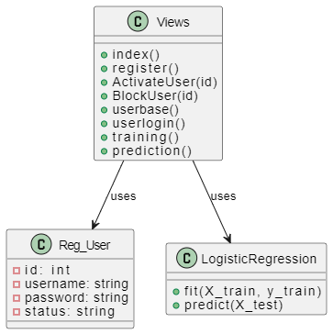
5.5 CLASS DIAGRAM:
In software engineering, a class diagram in the Unified Modeling Language (UML) is a type of static structure diagram that describes the structure of a system by showing the system's classes, their attributes, operations (or methods), and the relationships among the classes. It explains which class contains information.

Slide 22
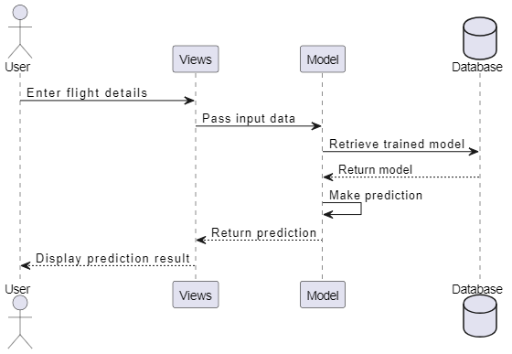
5.6 SEQUENCE DIAGRAM:
A sequence diagram in Unified Modeling Language (UML) is a kind of interaction diagram that shows how processes operate with one another and in what order. It is a construct of a Message Sequence Chart. Sequence diagrams are sometimes called event diagrams, event scenarios, and timing diagrams.

Slide 23
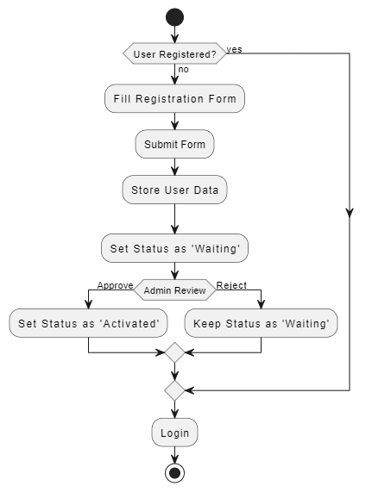
5.7 ACTIVITY DIAGRAM:
Activity diagrams are graphical representations of workflows of stepwise activities and actions with support for choice, iteration and concurrency. In the Unified Modeling Language, activity diagrams can be used to describe the business and operational step-by-step workflows of components in a system. An activity diagram shows the overall flow of control.

Slide 24
6. TEST CASES:
Test Case No. | Test Scenario | Test Steps | Expected Outcome
1 | Valid Input Data | 1. Input valid data for all fields (e.g., FL_DATE, TAIL_NUM, CRS_DEP_TIME). | Form should submit successfully and display prediction result.
 |  | 2. Submit the form.
2 | Invalid Flight Date | 1. Input an invalid or future date for FL_DATE. | The form should reject submission and show an error message like "Invalid date."
 |  | 2. Submit the form.
3 | Missing Required Fields | 1. Leave some required fields (e.g., OP_UNIQUE_CARRIER) blank. | Error messages should indicate missing fields, and no prediction is made.
 |  | 2. Submit the form.
4 | Predicting for Canceled Flight | 1. Set CANCELLED to 1. | The system should display a message like "Flight is canceled," and no prediction is made.
 |  | 2. Fill other fields with valid data.
 |  | 3. Submit the form.
5 | Invalid Airport ID | 1. Input invalid data for ORIGIN_AIRPORT_ID or DEST_AIRPORT_ID. | Error message should display "Invalid Airport ID."
 |  | 2. Submit the form.
6 | Valid Flight Number Format | 1. Input a valid numeric flight number in OP_CARRIER_FL_NUM. | Form should submit successfully, and a prediction should be displayed.
 |  | 2. Submit the form.

Slide 25
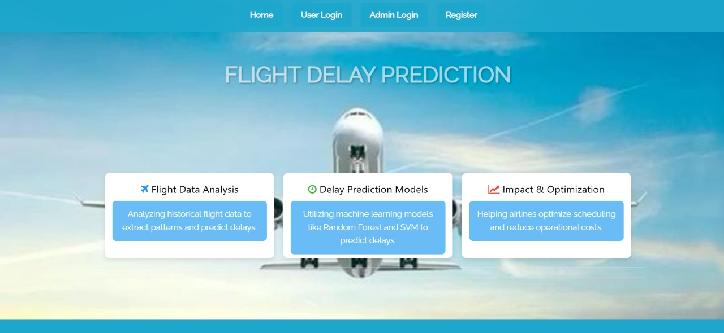
7. RESULTS:
Fig. Home Page

Slide 26
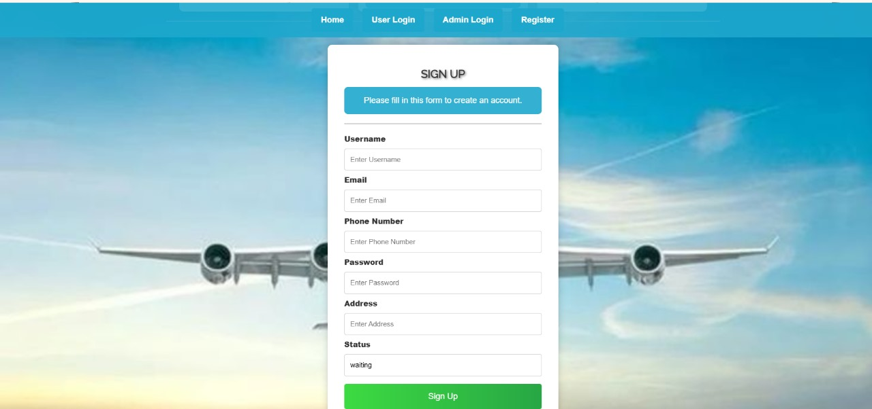
Fig. User Registration Page

Slide 27
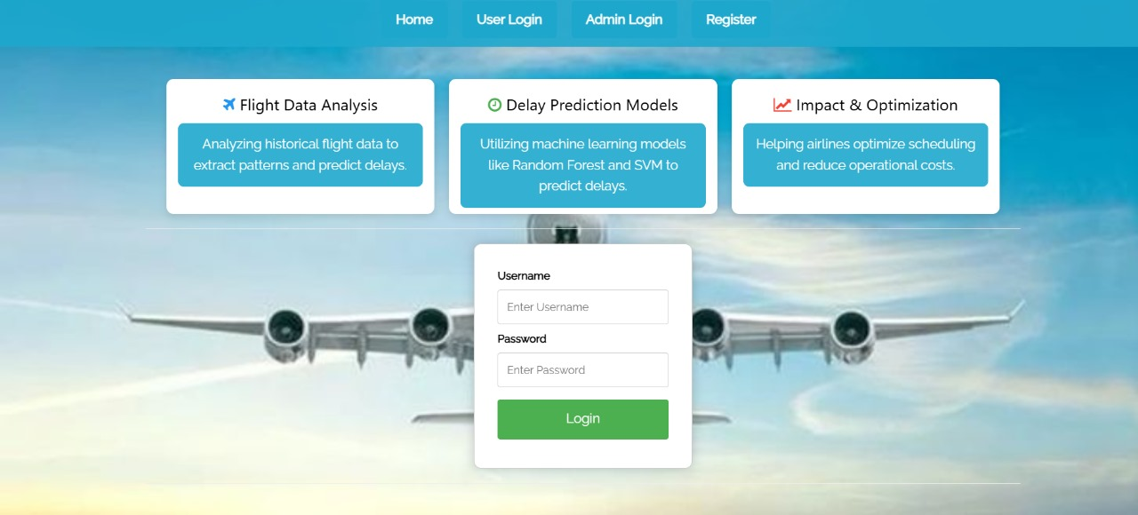
Fig. User Login Page

Slide 28
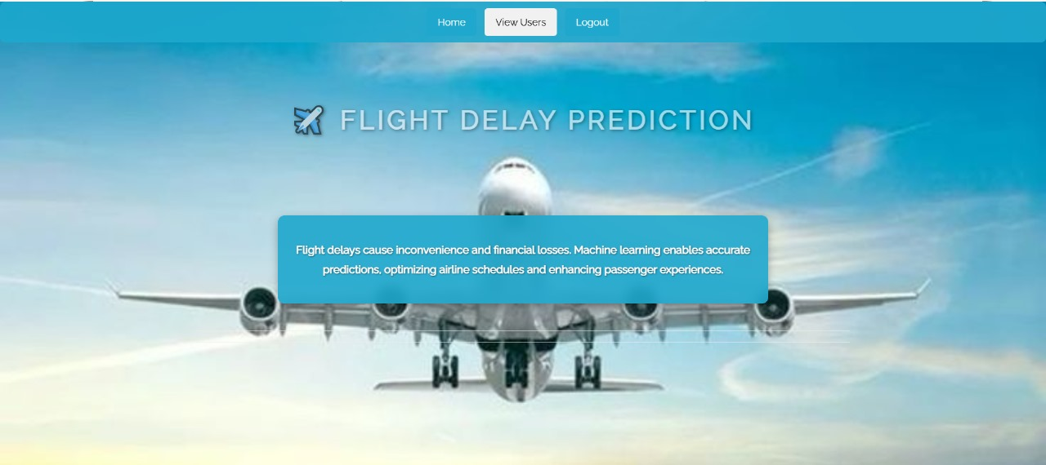
Fig. Admin Home Page

Slide 29

Fig. User Home Page

Slide 30

Fig. Training Result Page

Slide 31
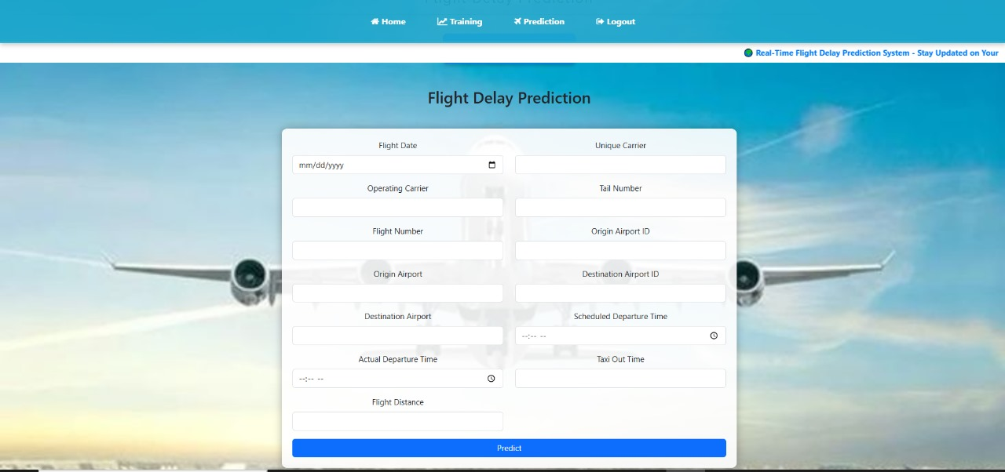
Fig. Flight Delay Prediction Page

Slide 32
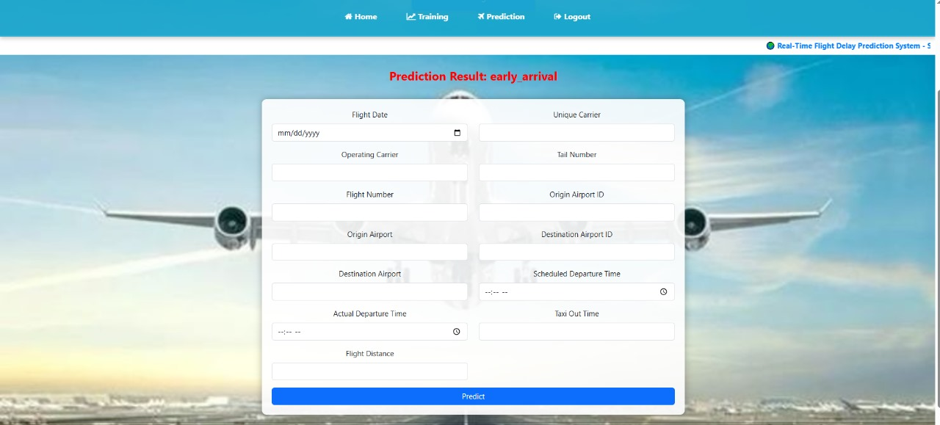
Fig: Prediction Result

Slide 33
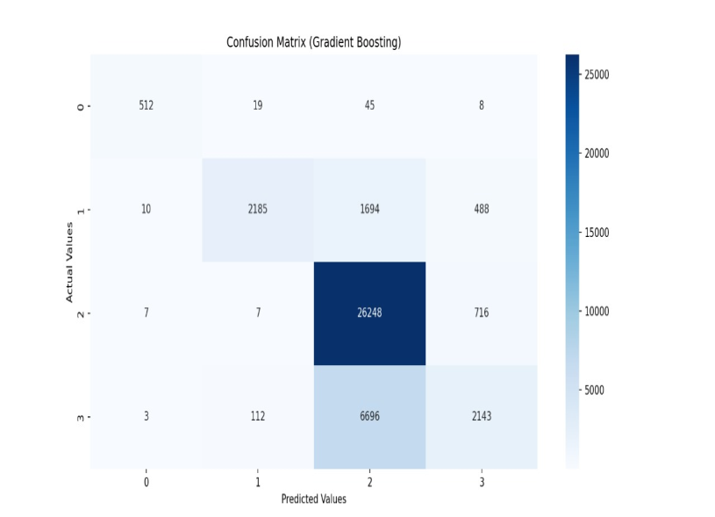
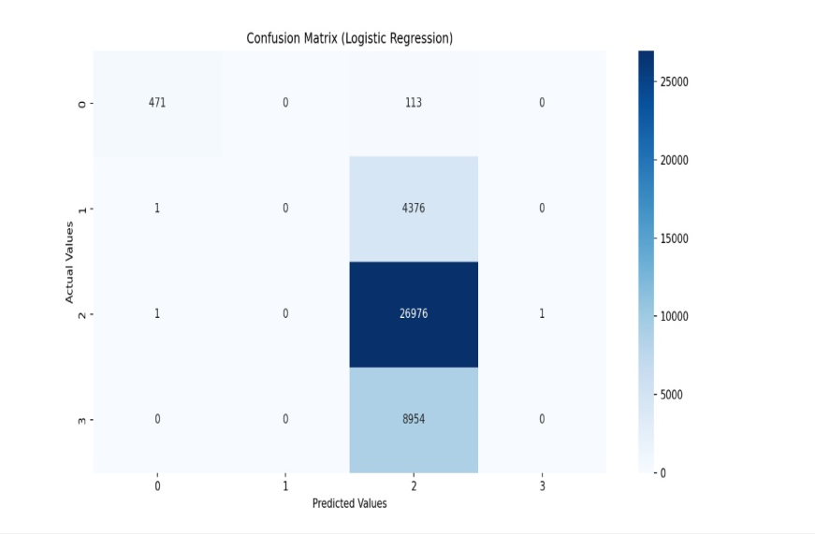
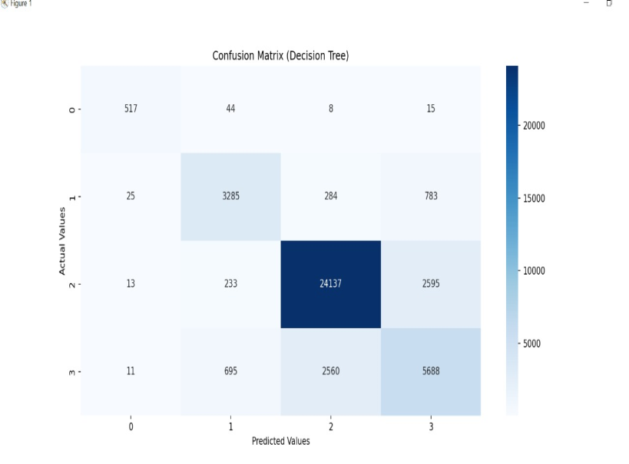
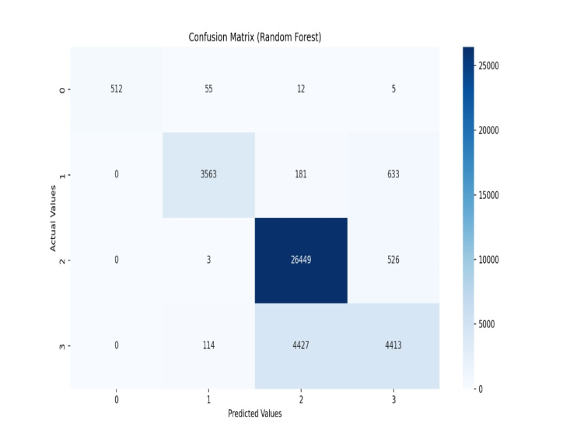
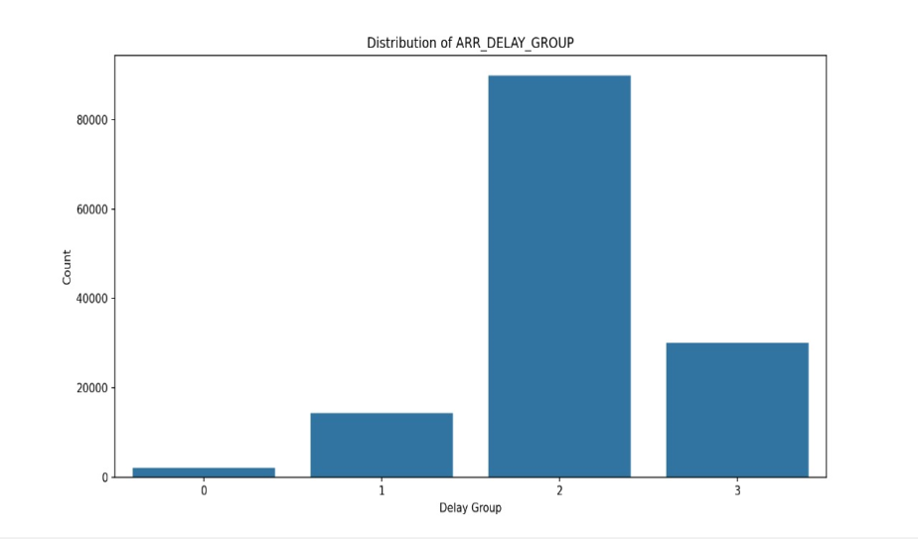
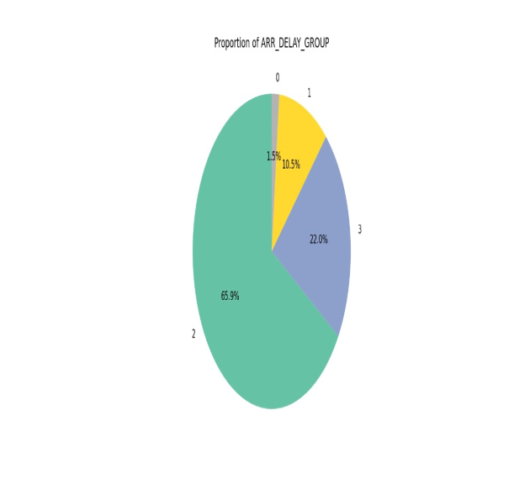
Graphs:

Slide 34
8. CONCLUSION:
Our research showed that aircraft delay predictions may be made with good accuracy using machine learning methods. In addition to evaluating delays for different human requirements, the previously mentioned categorization and analysis aims to closely examine elements that impact delays, including ‘weather delay,’ ‘airline delay,’ and ‘security delay.’ The SVM model performed the best, correctly categorizing delays into two groups using the previously mentioned parameters including ‘Departure Time,’ ‘Air Time,’ and ‘Month’—with 100% accuracy. Thus, it can be effectively used to predict flight delays, which will be beneficial for airports and airlines, as well as passengers. Therefore, the study of flight delays presented in this paper is grounded entirely in scientific parameters, underscoring its crucial significance in the aviation industry.

Slide 35
FUTURE ENHANCEMENT:
To enhance flight delay prediction, advanced machine learning models like Random Forest, SVM,
and Gradient Boosting Machines (GBM) can be implemented, along with deep learning models
such as CNN-LSTMs for sequential data analysis. Feature engineering should include time-based
attributes (day, month, time of day), weather data integration, and derived date differences
. Hyperparameter tuning using Grid Search, Random Search, or Bayesian Optimization caoptimize
model performance, while k-fold cross-validation and metrics like precision, recall, F1-score, and
ROC-AUC ensure robust evaluation. Visualizations such as ROC curves, Precision-Recall curves, and Feature Importance charts, along with SHAP explanations, can improve interpretability.
Incorporating real-time weather data via APIs enhances predictions, and deploying the model
as a REST API using Flask, Django REST Framework, or FastAPI makes it accessible for
real-world applications.

Slide 36
THANK YOU

